Slide 1
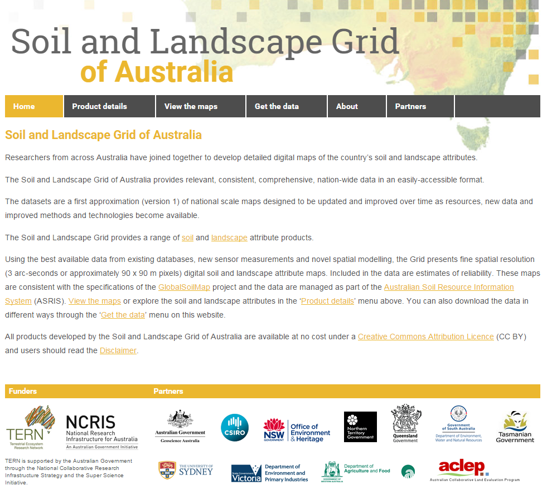
Soil and Landscape Grid of Australia Usage Report
Period : 4/11/2014 to 27/5/2019 (~ 4.5Yrs)
Data downloads = 168 Tb of data
WCS = 67.7 Tb (1.3M downloads)
CSIRO DAP = 31.2 Tb (4291 downloads)
FTP = 68.5 Tb (9412 downloads)
Web site
Visits = 54770(average = 240 per week)
Total number of countries viewing = 156
Map Views
Views = 979115 (average = 3892 per week)
Video views : 8272
https://www.youtube.com/watch?v=Z5-ZPVznMEw
http://www.clw.csiro.au/aclep/soilandlandscapegrid

Slide 2
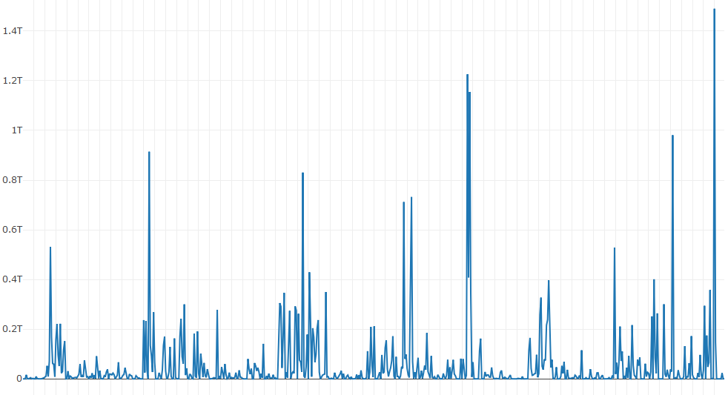
Daily Web Coverage Service (OGC WCS) Data Downloads
2015
2016
2017
2018

Slide 3
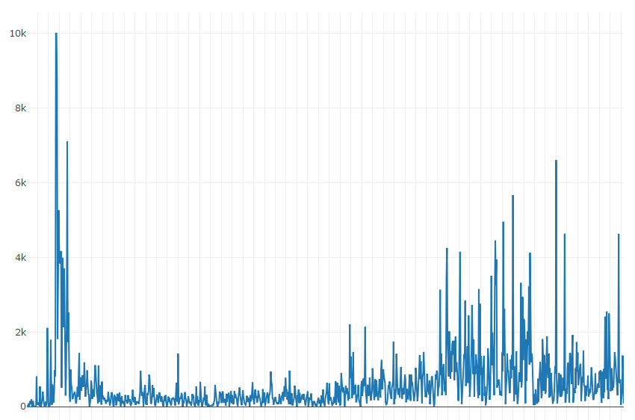
Views - Daily Counts of SLGA Map Views
2015
2016
2017
2018

Slide 4
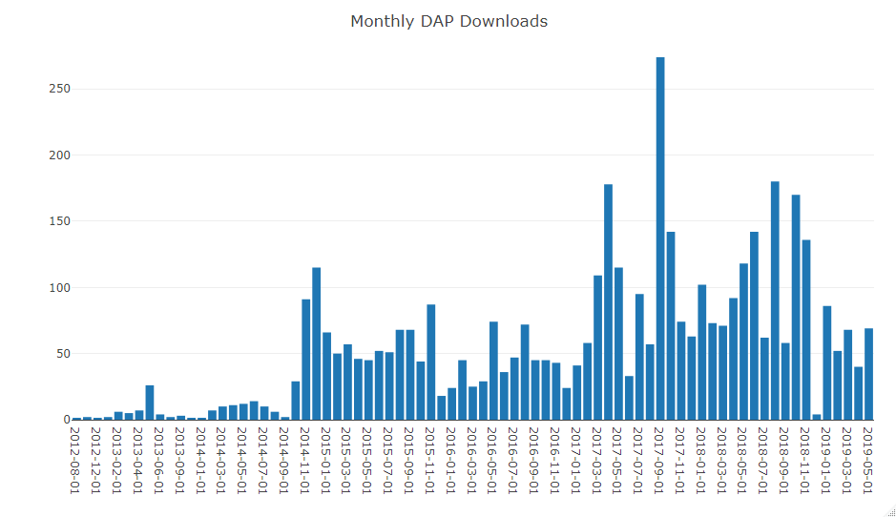

Slide 5
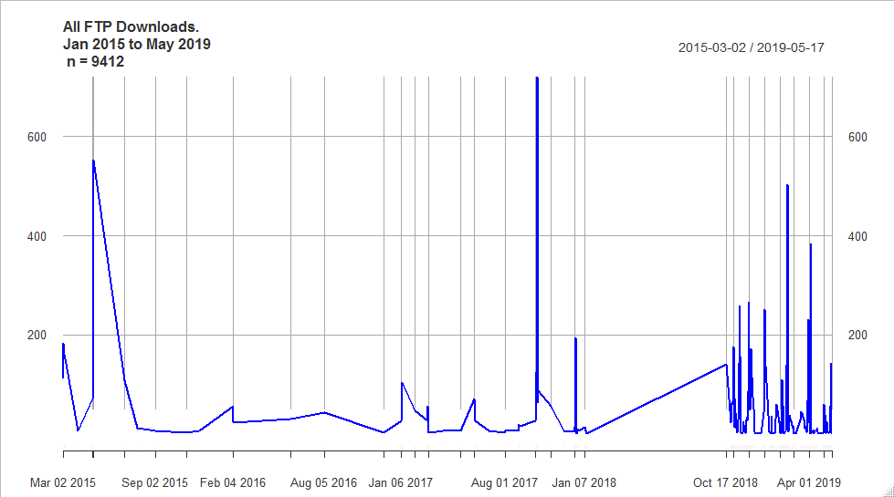
FTP Downloads
Product | Count
Clay | 1310
AWC | 1308
Bulk-Density | 855
Sand | 843
SOC | 722
Silt | 717
pHc | 714
Total_N | 633
Depth_of_Soil | 596
ECEC | 580
Total_P | 521
Relief | 332
Depth_of_Regolith | 177

Slide 6
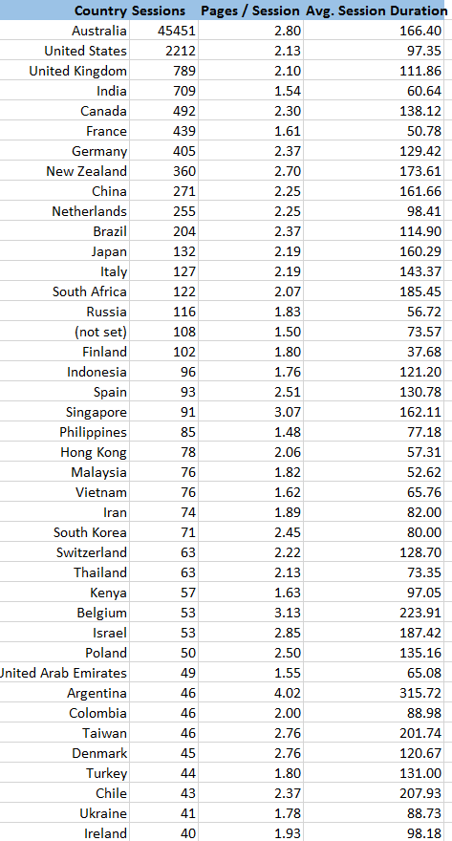
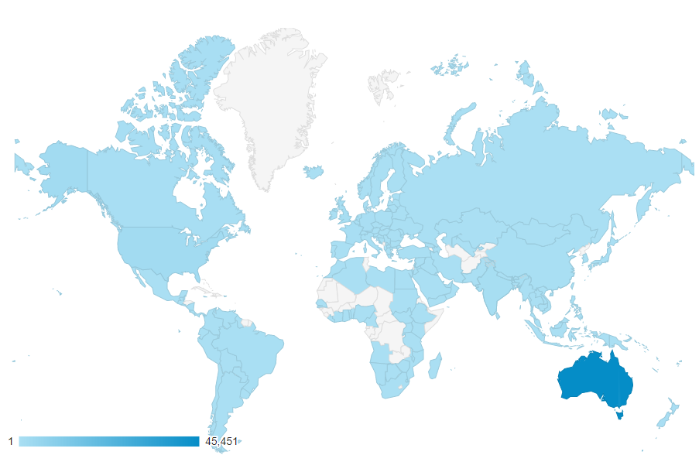
Web Site - Countries viewing the SLGA web site

Slide 7
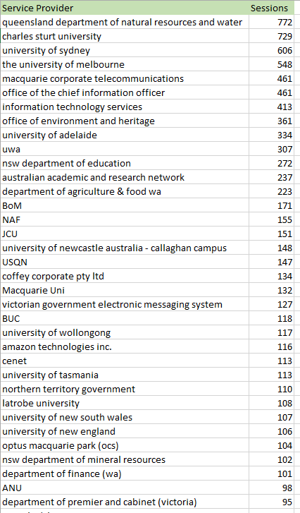
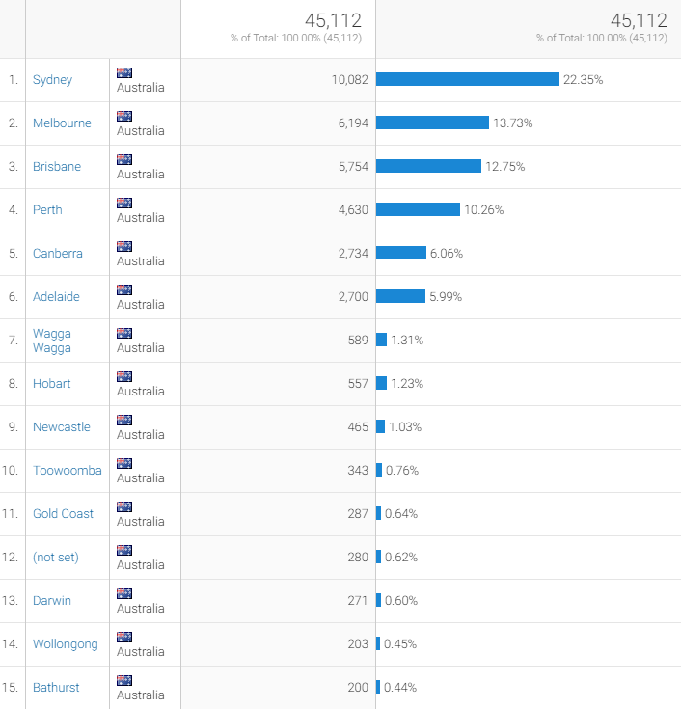
Web Site Usage Info
Users
Locations

Slide 8
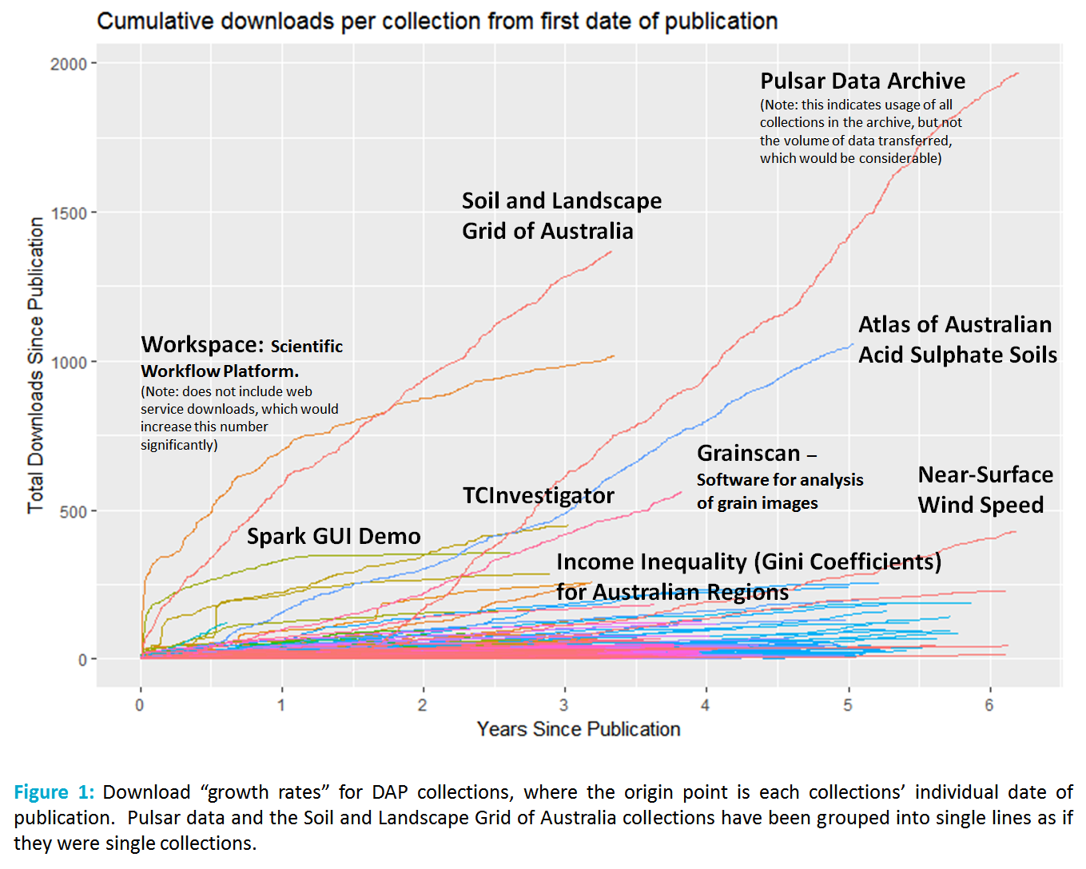
CSIRO DAP Downloads
(Dominic Hogan - 2016)

