Slide 1
Managing derived soil profile data
Dennis van Gool, Ted Griffin, Simon Woodman

Slide 2
Andrew Biggs and Ross Searle in 2017 “Towards improved quality of soil morphology and analytical data in Australia: starting the discussion”
Closely associated with this discussion is managing derived values to
account for variable quality and assumptions
capture soil expertise
ie managing all rules that go into a spreadsheet view of a soil property that can feed directly into a model.

Slide 3
We do not manage soil data well
More is captured under the delusion that better use will automatically follow
Little thought is given on how the information will be managed so:
knowledge is not lost
models have a reliable starting point

Slide 4
We do have
TERN Soil Federator and work has started on
Australian national soil information system (ANSIS)
(and ASRIS and collaboration with Universities etc)
BUT
Even good soil profile data is difficult to use by specialists familiar with this data

Slide 5
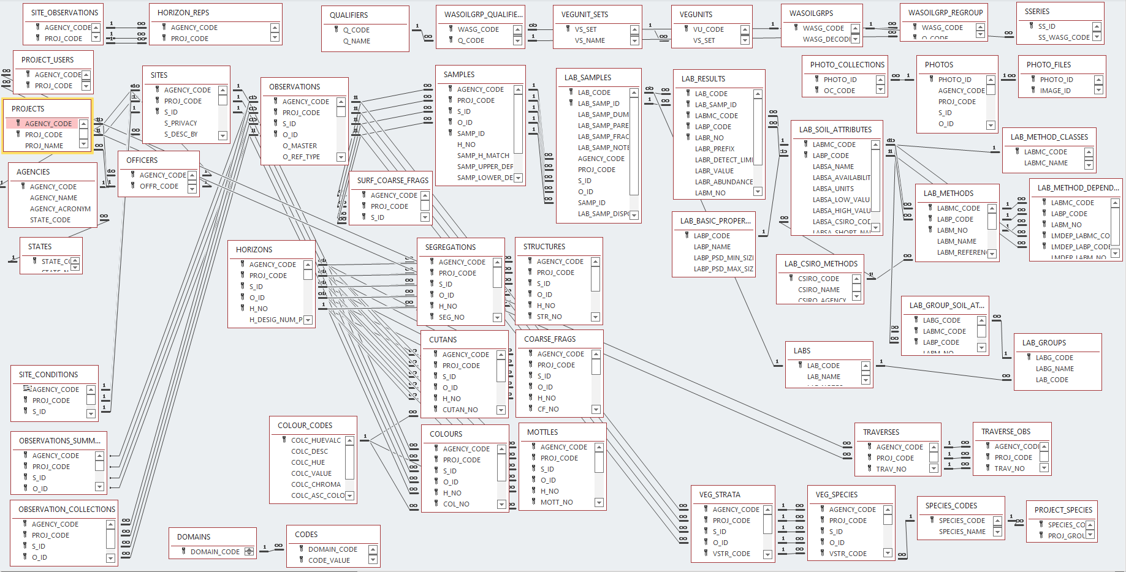
The problems discussed by Biggs and Searle are compounded by a complicated data structure.
LOTS TO CONSIDER !

Slide 6
Two quick examples
(from the soil landscape grid of Australia)

Slide 7
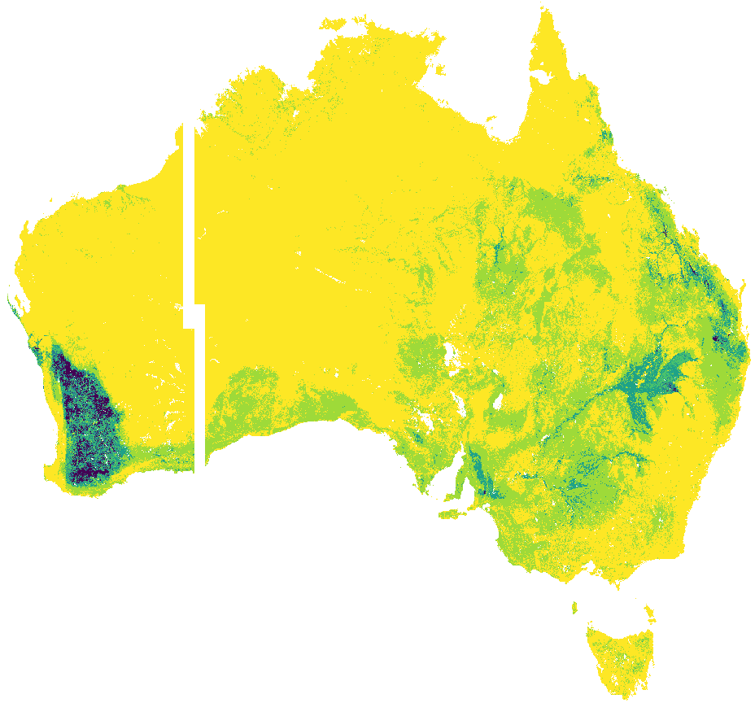
First draft of available Phosphorus 0-5cm
WA does not have more available Phosporus than the rest of Australia
*Incorrect lab method was a significant problem
(Colwell P ppm ?)

Slide 8
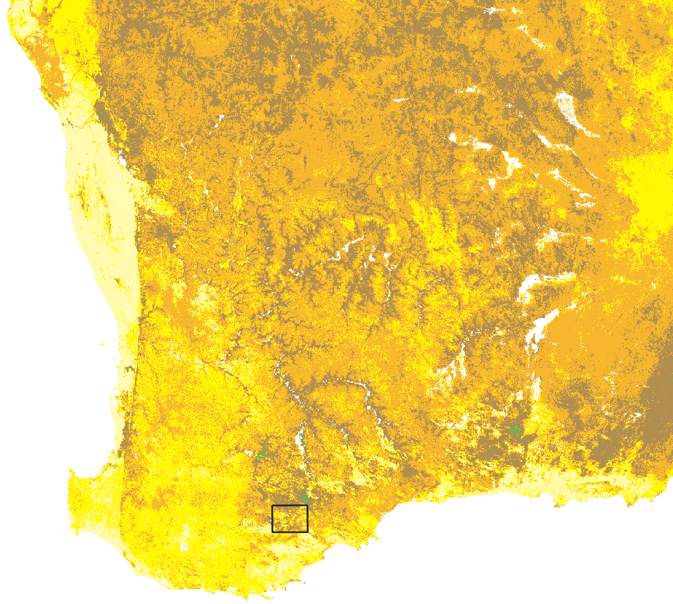
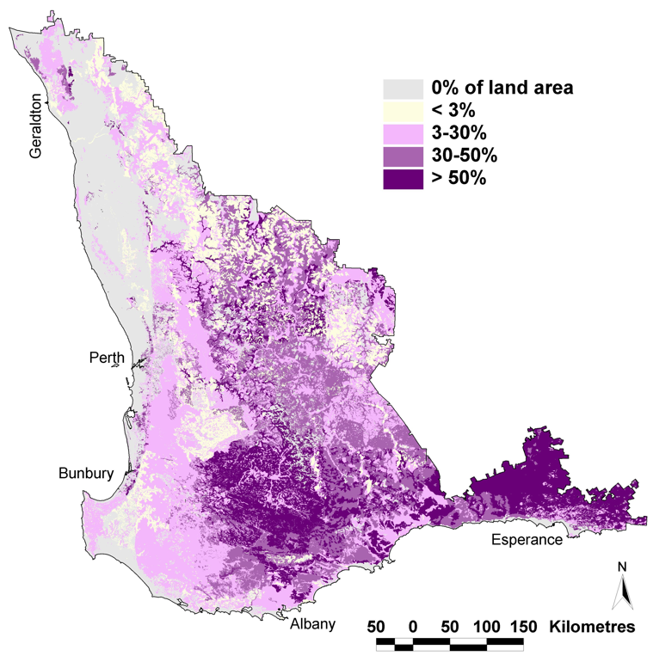
Sand over clay texture contrast soils dominate SW of WA
SLGA clay prediction 15 to 30cm
Sodosols
Lots of clay
Sand
Little clay
Clay
Hydrological and crop yield modelling will be wrong
*Fixed depth is a significant problem

Slide 9
** It is great that this information is available! If we document faults improvements can be made and mistakes not repeated**
A poor result is still a result!

Slide 10
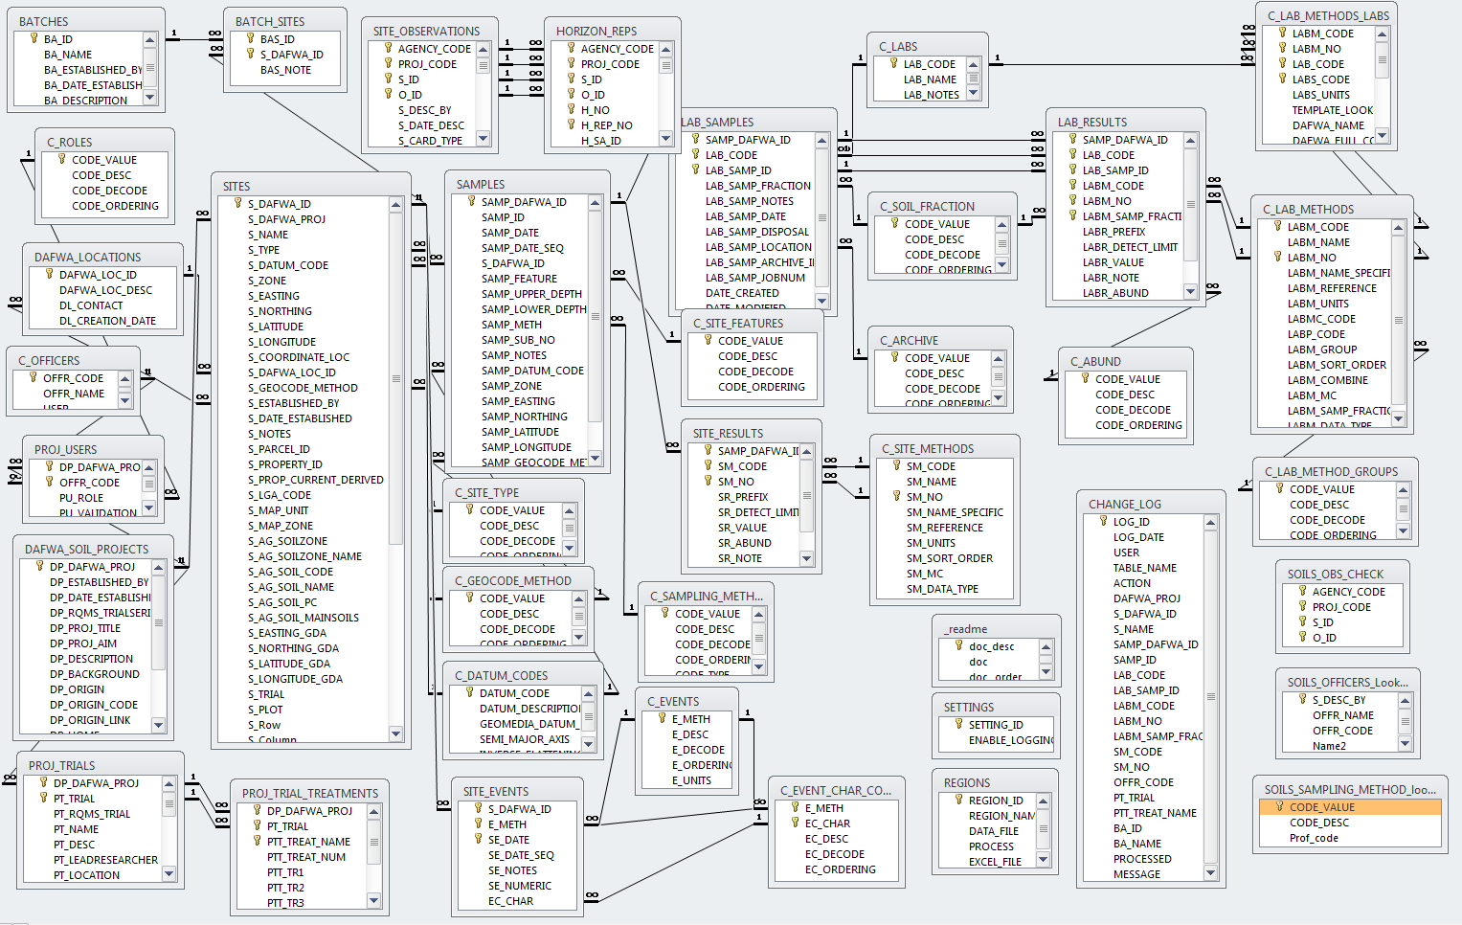
All tables have a site identifier, and attribute and a value
SUMMARY_SAMPLES (also has sample identifier)
SOIL DATA
SUMMARY_HORIZONS (also has horizon)
SUMMARY_OBSERVATIONS
SOURCE QUERIES and DEPENDENCIES
Job done!?
SUMMARY (Spreadsheet, CSV etc) – The summaries for Modelers to use

Slide 11
Example – Subsoil pH in texture contrast clay
Maximum pH at a specific depth e.g. 15-30cm is easy…..But in WA data there are
11 Laboratory pH methods
8 Field pH methods (plus undocumented)
Much pH data is very old
Subsoil is not at 15-30cm
Need pH in texture contrast layer, but texture contrast layer is poorly recorded.
I have >10 pH queries and >12 texture queries to derive soil type and texture contrast *(It has around 80% match to available classified profiles)
The result is a spreadsheet view of soil information summarized for each site

Slide 12
The spreadsheet summary
(Job done?)
AGENCY | PROJ_CODE | S_ID | O_ID | Maximum Subsoil pH(w) | Depth to texture change (cm) | Likely soil | decode
501 | ADA | 0001 | 1 | 5.4 | 12 | SLD | Shallow loamy duplex
501 | ADA | 0002 | 1 | 6.6 | 50 | SE | Sandy Earth
501 | ADA | 0003 | 1 | 5.8 | 65 | DS | Deep sand

Slide 13
The valuable (exciting ☺ ) part – the logic or assumption are captured as data.
Source SQL and dependencies are updated by code with the push of a button (or this could be automated)
ID | TABLE | PARAM | SOURCE_SQL | ORDER | LAST_ RUN | COUNT
680 | Obser-vations | Subsoil pH | SELECT SH.AGENCY_CODE, SH.PROJ_CODE, SH.S_ID, SH.O_ID, Sum(H.H_LOWER_DEPTH-H.H_UPPER_DEPTH) A FROM ((SOILS_C.SUMMARY_OBSERVATIONS SO INNER JOIN SOILS_C.SUMMARY_OBSERVATIONS SO2 ON (SO.O_ID = SO2.O_ID) AND (SO.S_ID = SO2.S_ID) AND (SO.PROJ_CODE = SO2.PROJ_CODE) AND (SO.AGENCY_CODE = SO2.AGENCY_CODE)) INNER JOIN SOILS_C.SUMMARY_HORIZONS SH ON (SO.AGENCY_CODE = SH.AGENCY_CODE) AND (SO.PROJ_CODE = SH.PROJ_CODE) AND (SO.S_ID = SH.S_ID) AND (SO.O_ID = SH.O_ID)) INNER JOIN SOILS_C.HORIZONS H ON (SH.AGENCY_CODE = H.AGENCY_CODE) AND (SH.PROJ_CODE = H.PROJ_CODE) AND (SH.S_ID = H.S_ID) AND (SH.O_ID = H.O_ID) AND (SH.H_NO = H.H_NO) WHERE (((SH.H_NO)>=SO2.SUM_VAL_NUMBER+1) AND ((SH.SUM_VAL_NUMBER)>=8) AND ((SO.SUM_PARAM_CODE)='SO_DUPDEPTH2') AND ((SH.SUM_PARAM_CODE)='SH_PHW') AND ((SO2.SUM_PARAM_CODE)='SO_DUPMINH_NO2') AND ((H.H_UPPER_DEPTH)<80)) OR (((SH.H_NO)>=SO2.SUM_VAL_NUMBER+2) AND ((SH.SUM_VAL_NUMBER)>=8) AND ((SO.SUM_PARAM_CODE)='SO_DUPDEPTH2') AND ((SH.SUM_PARAM_CODE)='SH_PHW') AND ((SO2.SUM_PARAM_CODE)='SO_DUPMINH_NO2') AND ((H.H_UPPER_DEPTH)<80)) GROUP BY SH.AGENCY_CODE, SH.PROJ_CODE, SH.S_ID, SH.O_ID HAVING (((Sum(H_LOWER_DEPTH-H_UPPER_DEPTH)) Is Not Null)) OR (((Sum(H_LOWER_DEPTH-H_UPPER_DEPTH)) Is Not Null)) | 1 | 11-Aug-22 | 9797
DEPENDENCIES
TABLE | PARAM | PARAM used | TABLE used
Horizons | PH(w) Lab | PH(w) Samples | Samples
 |  | PH(w) Field | Horizons
Horizons | PH (w) | PH(w) Lab | Horizons
 |  | PH (w) | Horizons
Obser-vations | Subsoil pH | Depth to clay texture contrast | Obser-vations
Logical sequence of queries added to get result

Slide 14
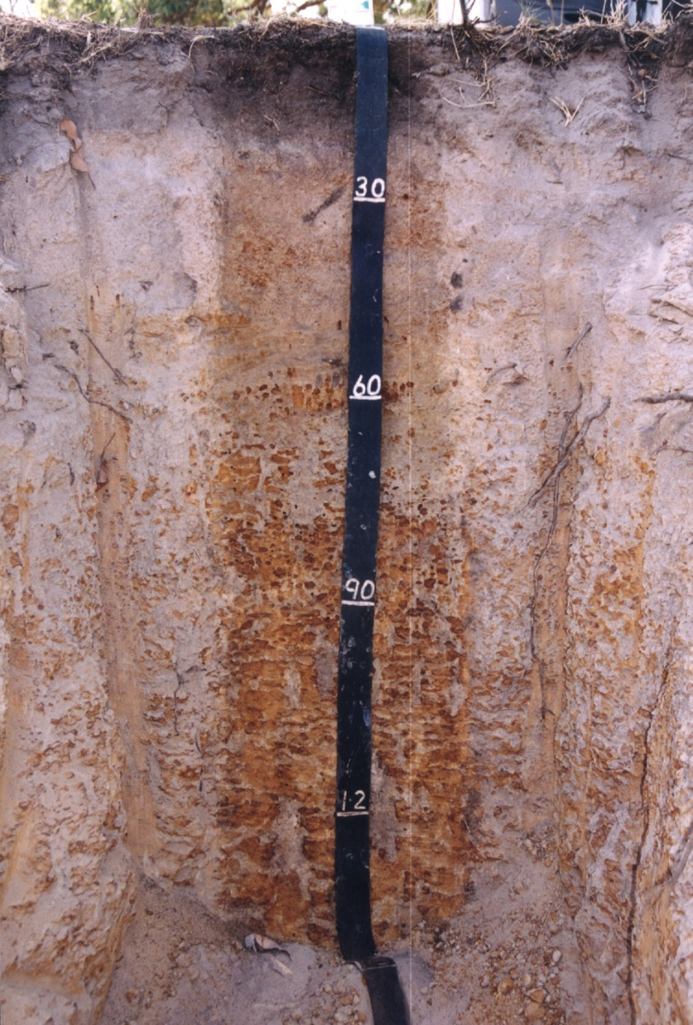
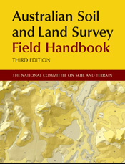
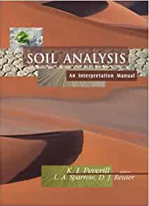
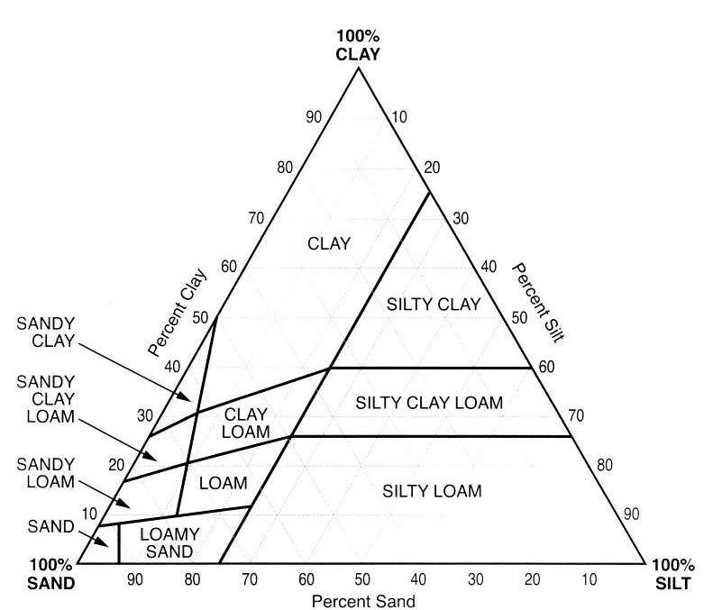
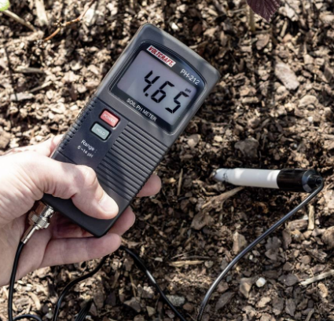
Capture soils expertise
Capture (and test)
logic
soil research
local knowledge
widely accepted rules
A new idea!
pHwater=0.997pHCaCl2 + 0.853

Slide 15
All tables have a site identifier, and attribute and a value
SUMMARY_SAMPLES (also has sample identifier)
SOIL DATA
All part of one system. The source queries and how they relate are captured
SUMMARY_HORIZONS (also has horizon)
Derived
SUMMARY_OBSERVATIONS
SUMMARY_SOURCE_QUERY and PARAMETERS DEPENDENCIES
Consistent and updatable
Confidence in the data
SUMMARY_VIEWS – The summaries for Modelers to use

Slide 16
Summary
1 managing soil rules so that the same mistakes are not made over and over (what is happening now).
2 Data quality is captured as part of the logic or assumptions applied to the data. (Plus some new fields/tables in the database)
3 Uses small logical steps *so you do not need to be a grand chess master to follow them through - but will need patience as there are often a lot of steps
4 The summaries update as:
more data is added or changed
the logic or assumptions are corrected or changed

Slide 17
If we manage the rules even poor soil data has value.
This allows for continual improvement.
Modelers and researchers are not database gurus.
**If they spend less time massaging complex, variable data, they can concentrate on model development and research…….and outputs**
(…………This development is in an oracle database, but the SQL is transferable)

Slide 18
Thank you
Visit dpird.wa.gov.au
Important disclaimer The Chief Executive Officer of the Department of Primary Industries and Regional Development and the State of Western Australia accept no liability whatsoever by reason of negligence or otherwise arising from the use or release of this information or any part of it.
© State of Western Australia 2018

