Slide 1
New Zealand soil spectral libraries
Yuxin Ma, Pierre Roudier, Sam Carrick, John Triantafilis

Slide 2
Spectra data in NZ
Soil properties | Vis-NIR | MIR
Total carbon (%) | 8,345 | 3,108
Total nitrogen (%) | 8,341 | 3,049
pH (H₂O) | 2,381 | 2,542
Sand (%) | 2,160 | 2,875
Silt (%) | 2,160 | 2,875
Clay (%) | 2,160 | 2,875
Phosphate retention (%) | 2,059 | 3,075
Available Water Capacity (%) | 979 | 2,289
Notes:
(updating) 11312 after removing replicates from 115000
MIR 3581+3112

Slide 3
Pre-processing of spectra
Convert reflectance to absorbance
A= (log(1/R)
Savitzky–Golay smoothing filter
window size of 9 for vis-NIR, 7 for MIR
second-order polynomial
first-order derivative
Trim low signal-to-noise ratio
Vis-NIR: < 500 nm and between 2450– 2500 nm
MIR: > 4000 cm-1 and < 600 cm-1
Standard normal variate (SNV)
for each spectrum; scatter correction

Slide 4
Performances of vis-NIR spectra library (validation)

Slide 5
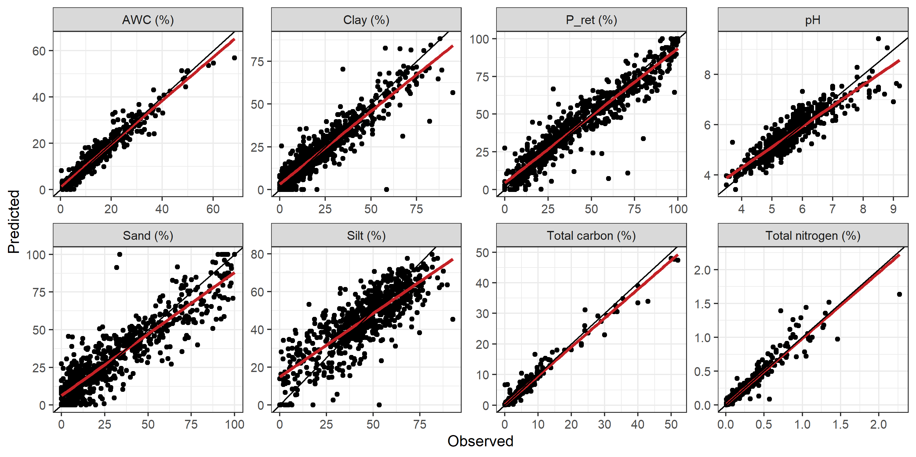
Performances of MIR spectra library (validation)

Slide 6
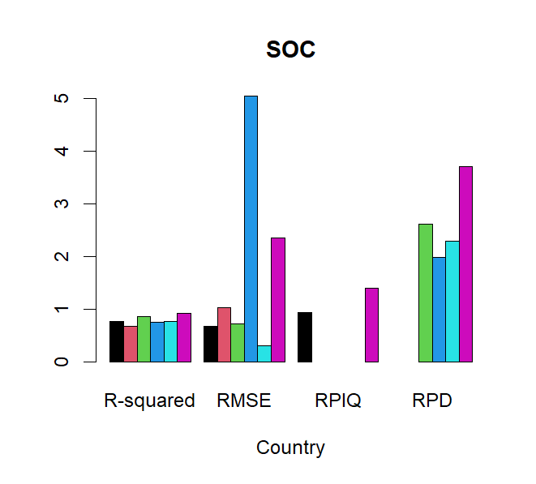
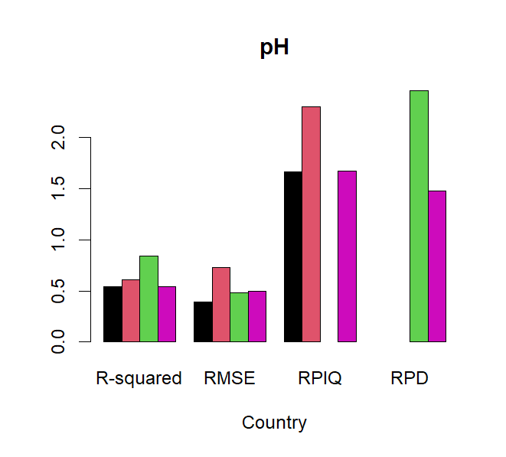
Comparison with other libraries

Slide 7
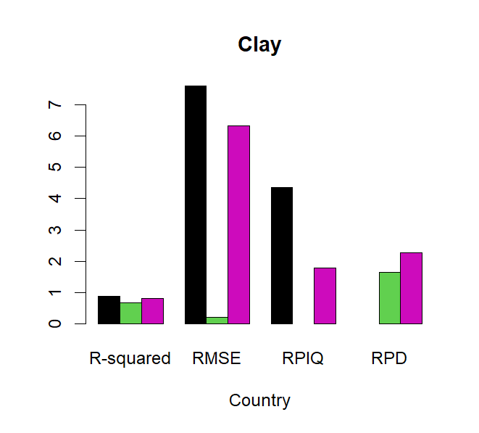
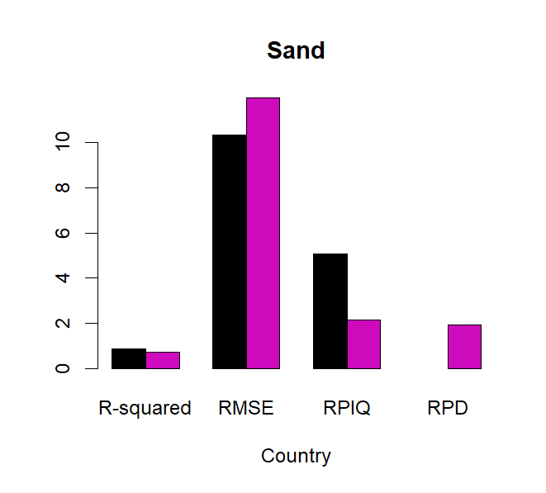
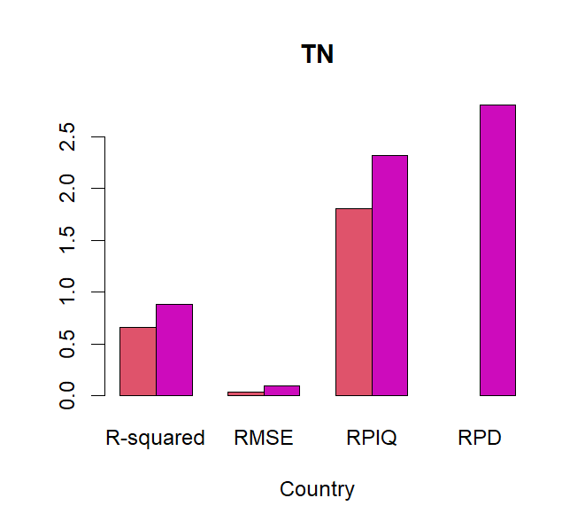
Comparison with other libraries

Slide 8
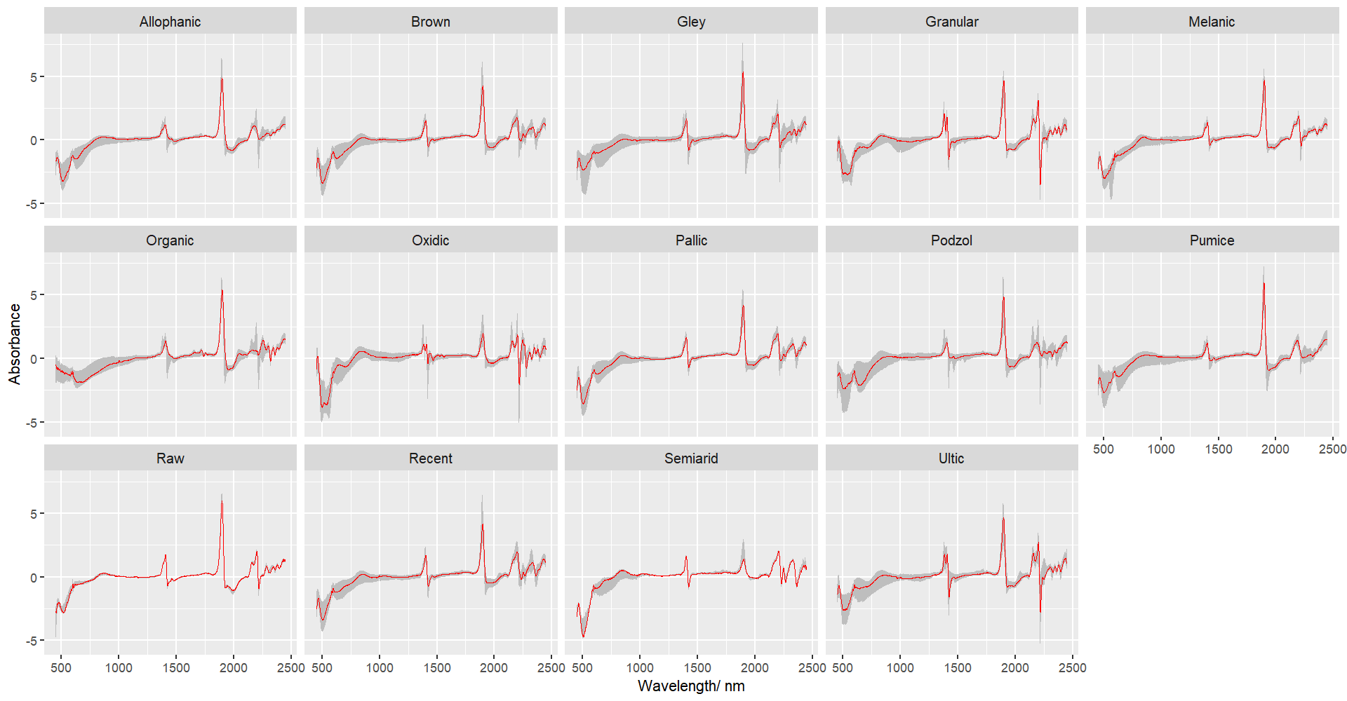
Vis-NIR spectra for NZSC soil orders
Absorption peaks at around 1875 nm
Small fluctuation for Oxidic and Semiarid
Oxidic and Semiarid: 500 nm
Granular: 2180nm

Slide 9
MIR spectra for NZSC soil orders
Oxidic: 3700 and 3200 cm-1
Organic had distinct spectral
features at 2700 to 3000 cm-1
Podzol and Ultic had absorption
peaks at around 800 cm-1

Slide 10
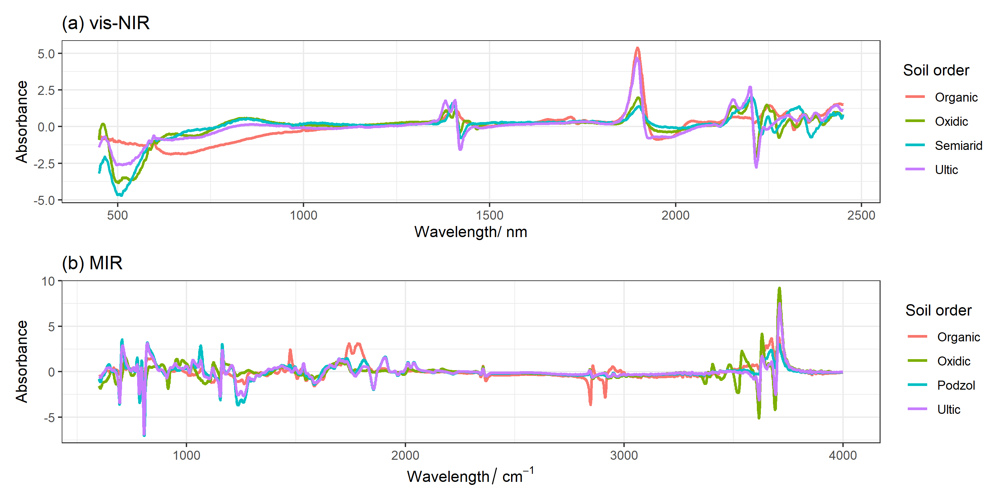
Comparison between NZSC soil orders
Classification | NZSC Soil orders
Young soils | Raw Recent Anthropic
Mature soils | Semiarid Pallic Brown Podzol Gley Organic Melanic Pumic Allophanic
Old soils | Ultic Granular Oxidic
Strongly weathered soils, e.g., Ultic, Oxidic and Granular showed distinct vis-NIR spectral features
The MIR showed clear peaks for soil orders with heavy- clay soil (Ultic) and high-soil organic matter (Organic and Podzols).
Hewitt 2010

Slide 11
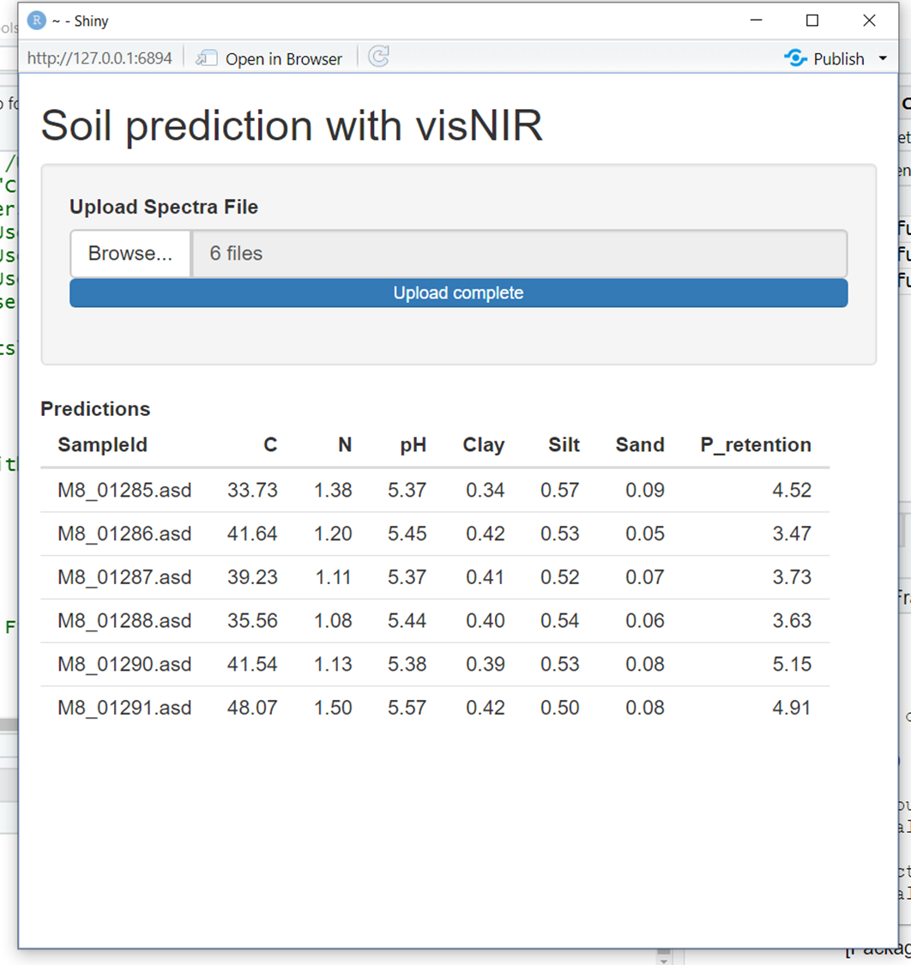
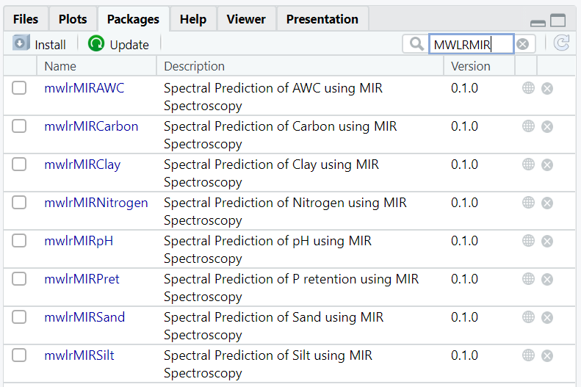
Using the libraries
R Shiny
R packages

Slide 12
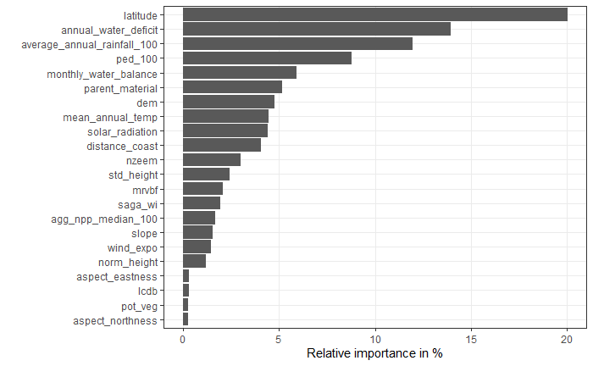
Applying the libraries – next step
P retention %)
Improve the P retention predictions by using spectra predictions

Slide 13
Summary
1) The vis-NIR and MIR SSL showed reliable modelling performance using PLSR model.
2) MIR outperforms vis-NIR for all soil attributes.
3) Vis-NIR and MIR have the potential to distinguish NZSC soil orders.
4) Time- and cost-efficient vis-NIR and MIR methodologies can be used to replace many of conventional soil analysis and assist soil surveys.

Slide 14
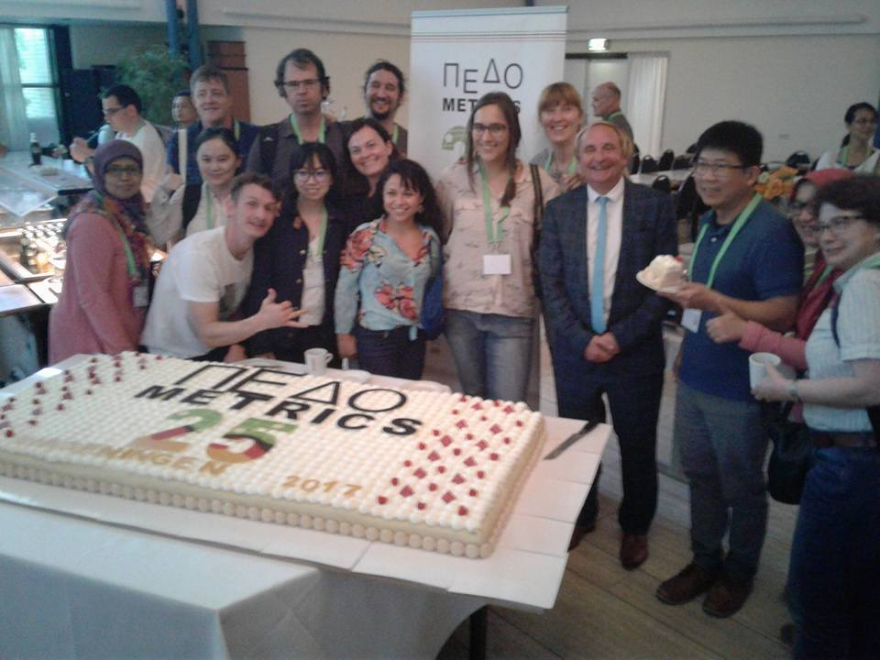
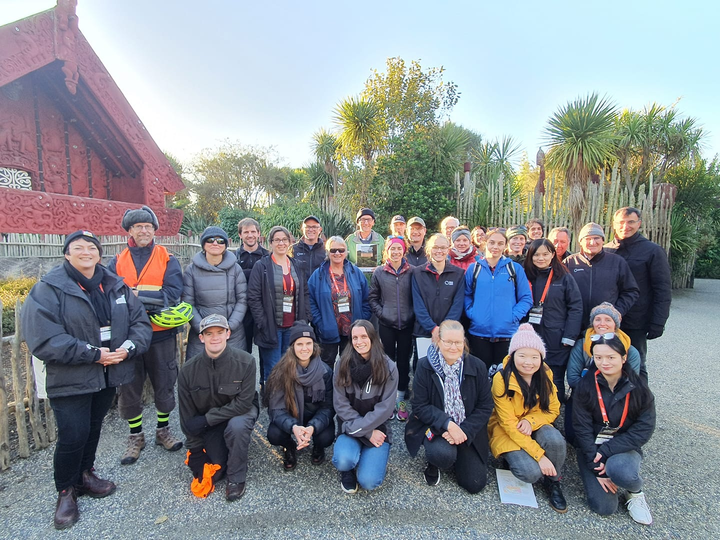
Dr Yuxin Ma
Manaaki Whenua – Landcare Research
Email: may@landcareresearch.co.nz
T +64 6 353 4996 | M +64 27 348 7809
www.landcareresearch.co.nz
Thank you!

