Slide 1
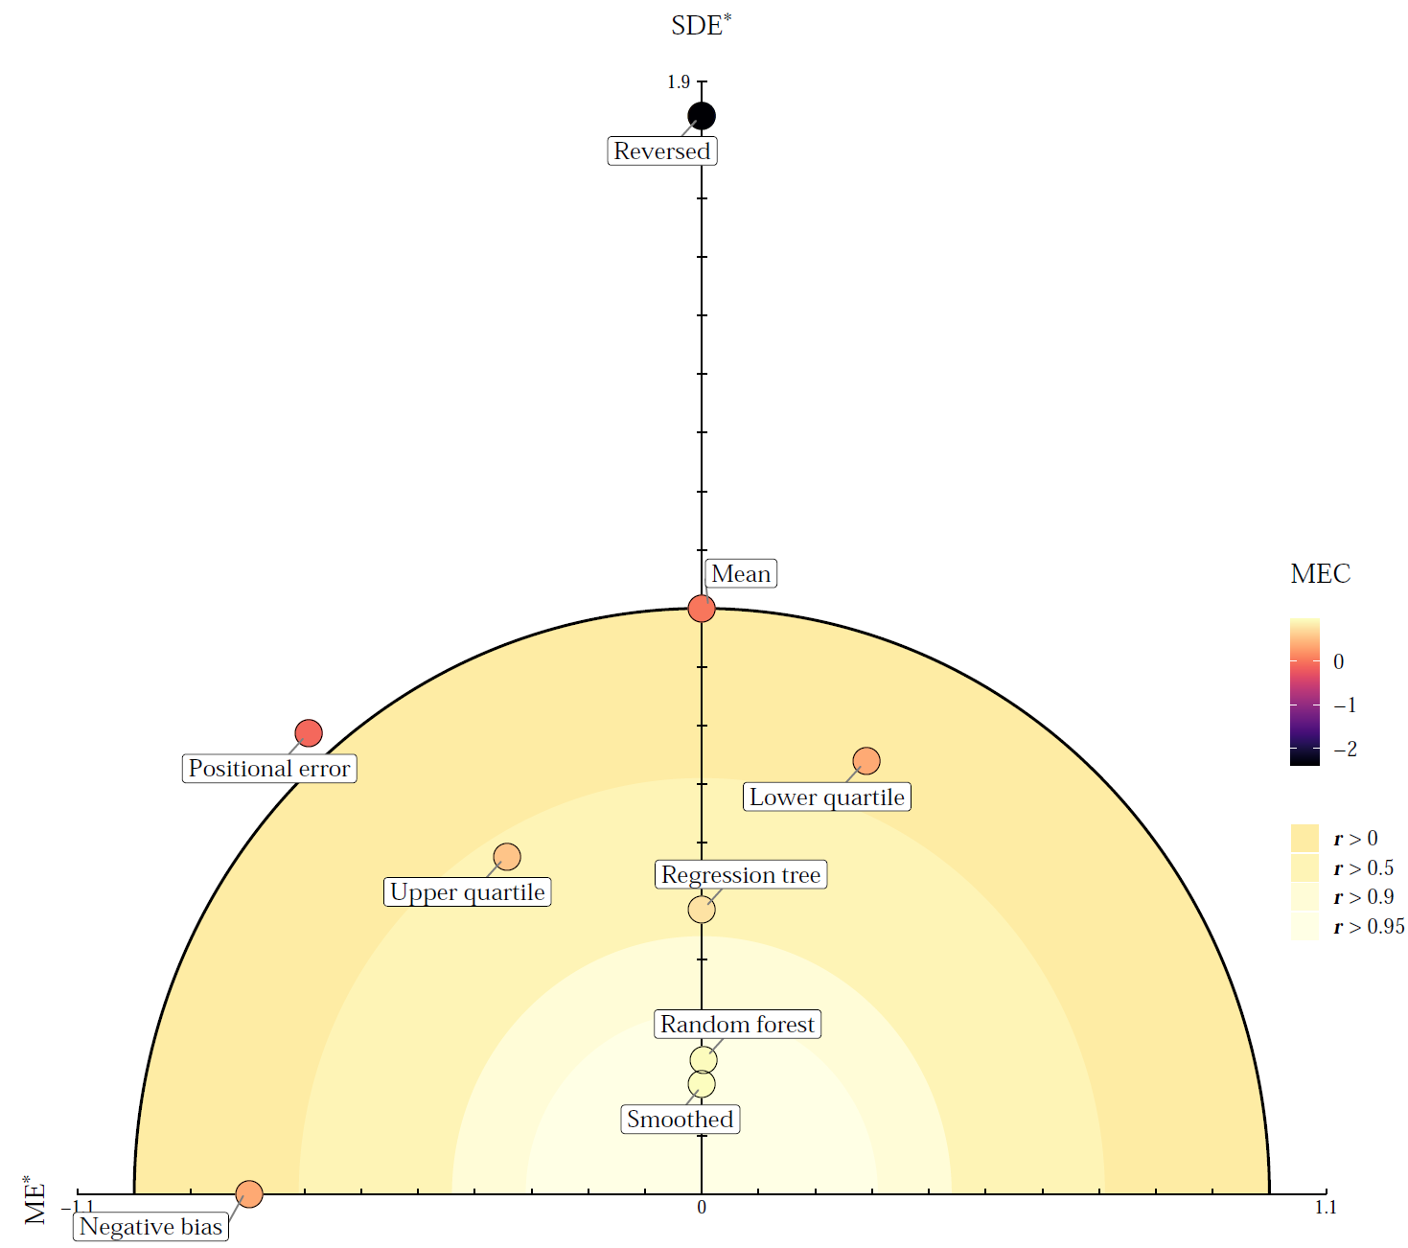
An integrated approach for the evaluation of quantitative soil maps through Taylor and solar diagrams
Alexandre Wadoux
Dennis Walvoort
Dick Brus

Slide 2
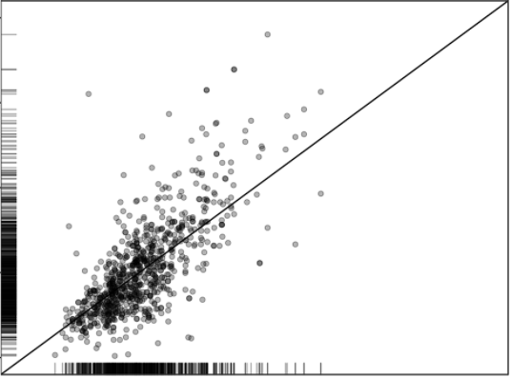
Statistical validation of soil maps
Global statistical indices
Predicted
Observed
$$ME=\frac{1}{N}\sum_{i=1}^{N}{ε(s_{i})}$$
$$r= \frac{\sum_{i=1}^{N}{(z\left(s_{i}\right)−\overline{z})(\hat{z}\left(s_{i}\right)−\overline{\hat{z}})}}{\sqrt{\sum_{i=1}^{N}{{\left(z\left(s_{i}\right)− \overline{z}\right)}^{2}}}\sqrt{{\left(\hat{z}\left(s_{i}\right)−\overline{\hat{z}}\right)}^{2}}}$$
$$RMSE=\sqrt{\frac{1}{N}\sum_{i=1}^{N}{ε{\left(s_{i}\right)}^{2}}}$$
$$MEC=1−\frac{\sum_{i=1}^{N}{{\left(z\left(s_{i}\right)−\hat{z}\left(s_{i}\right)\right)}^{2}}}{\sum_{i=1}^{N}{{\left(z\left(s_{i}\right)− \overline{z}\right)}^{2}}}$$
Notes:
ME indicate the systematic over- or underprediction
The RMSE shows the magnitude of the error, we square the error before averaging.
The r2 indicates the linear correlation between the predicted and observed values – between -1 and 1.
The MEC is similar to the MSE/variance of the observation. It ranges from –Inf to 1, where negative values indicate that taking the mean of the observation is a better predictor than the model, and positive values can be interpreted as an amount of variance explained.

Slide 3
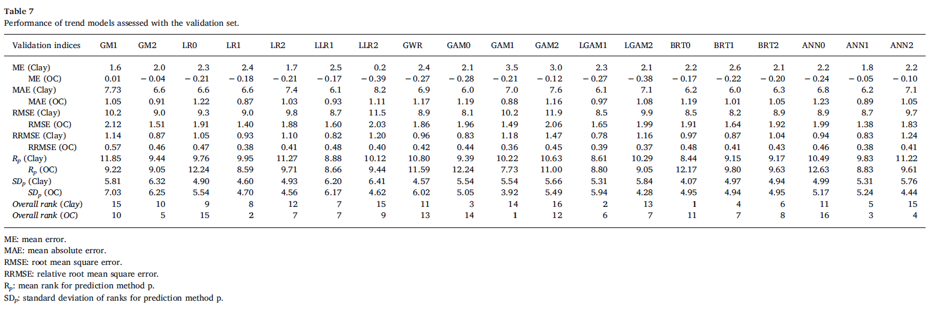
Google Scholar: “comparing digital soil maps”
Kempen, B., Brus, D. J., Stoorvogel, J. J., Heuvelink, G. B., & de Vries, F. (2012). Efficiency comparison of conventional and digital soil mapping for updating soil maps. Soil Science Society of America Journal, 76(6), 2097-2115.
Sindayihebura, A., Ottoy, S., Dondeyne, S., Van Meirvenne, M., & Van Orshoven, J. (2017). Comparing digital soil mapping techniques for organic carbon and clay content: Case study in Burundi's central plateaus. Catena, 156, 161-175.

Slide 4
Parameter tuning of two machine learning models
Realization of the model OC (g/kg) | RMSE |  | r |  | CCC |  | MEC |  | MAE |  | ME
 | model 1 | model 2 | model 1 | model 2 | model 1 | model 2 | model 1 | model 2 | model 1 | model 2 | model 1 | model 2
model parameter set 1 | 5.77 | 5.00 | 0.33 | 0.54 | 0.28 | 0.32 | 0.04 | 0.20 | 0.15 | 3.08 | 3.84 | -0.99
model parameter set 2 | 5.69 | 3.92 | 0.20 | 0.57 | 0.20 | 0.38 | -0.48 | 0.26 | 0.59 | 2.48 | 3.45 | -0.65
model parameter set 3 | 2.49 | 2.30 | 0.53 | 0.59 | 0.49 | 0.42 | 0.23 | 0.30 | 0.49 | 1.57 | 1.83 | -0.31
model parameter set 4 | 2.00 | 1.73 | 0.39 | 0.62 | 0.12 | 0.41 | 0.09 | 0.29 | -0.17 | 1.21 | 1.47 | -0.31
model parameter set 5 | 1.65 | 1.59 | 0.22 | 0.38 | 0.07 | 0.16 | 0.03 | 0.06 | -0.19 | 1.11 | 1.17 | -0.35
model parameter set 6 | 2.20 | 1.89 | 0.10 | 0.10 | -0.02 | 0.01 | -0.14 | -0.14 | -0.62 | 1.21 | 1.33 | -0.51
model parameter set 7 | 18.12 | 12.15 | 0.17 | 0.57 | 0.17 | 0.43 | -0.56 | 0.29 | 13.62 | 8.61 | 3.91 | -2.13
model parameter set 8 | 17.54 | 11.90 | 0.00 | 0.58 | 0.05 | 0.45 | -0.49 | 0.30 | 13.50 | 8.66 | -0.21 | -1.68
model parameter set 9 | 18.60 | 12.01 | 0.20 | 0.56 | -0.16 | 0.47 | -0.62 | 0.29 | 15.60 | 9.37 | 2.35 | -0.56
model parameter set 10 | 24.29 | 11.85 | 0.32 | 0.55 | -0.29 | 0.46 | -1.93 | 0.29 | 19.60 | 9.67 | -7.02 | 0.03
model parameter set 11 | 18.86 | 11.20 | 0.17 | 0.53 | -0.16 | 0.43 | -1.06 | 0.24 | 15.15 | 8.73 | -5.15 | -0.16
model parameter set 12 | 17.50 | 11.20 | 0.00 | 0.53 | -0.04 | 0.38 | -0.77 | 0.21 | 13.42 | 8.62 | -6.26 | -1.11
model parameter set 13 | 1.00 | 0.75 | 0.10 | 0.32 | 0.05 | 0.17 | -0.56 | 0.07 | 0.77 | 0.56 | 0.50 | 0.04
model parameter set 14 | 0.86 | 0.72 | 0.17 | 0.36 | 0.11 | 0.21 | -0.24 | 0.10 | 0.69 | 0.54 | 0.32 | 0.05
model parameter set 15 | 0.86 | 0.70 | 0.50 | 0.65 | 0.28 | 0.55 | 0.13 | 0.38 | 0.70 | 0.53 | 0.29 | 0.08
model parameter set 15 | 1.51 | 0.77 | 0.14 | 0.73 | -0.15 | 0.66 | -0.89 | 0.50 | 1.16 | 0.59 | 0.09 | 0.08
model parameter set 17 | 1.44 | 0.84 | 0.30 | 0.68 | 0.22 | 0.61 | -0.59 | 0.42 | 1.18 | 0.67 | 0.81 | 0.12
model parameter set 18 | 1.54 | 0.95 | 0.17 | 0.63 | 0.06 | 0.54 | -0.58 | 0.25 | 1.39 | 0.77 | 0.94 | 0.24
model parameter set 19 | 0.43 | 0.39 | 0.39 | 0.52 | 0.17 | 0.27 | 0.12 | 0.19 | 0.29 | 0.27 | -0.01 | -0.04
model parameter set 20 | 0.36 | 0.32 | 0.33 | 0.54 | 0.16 | 0.33 | 0.10 | 0.23 | 0.25 | 0.23 | -0.01 | -0.04
model parameter set 21 | 0.30 | 0.24 | 0.14 | 0.60 | 0.08 | 0.33 | 0.00 | 0.24 | 0.20 | 0.17 | -0.03 | -0.04
model parameter set 22 | 0.28 | 0.23 | 0.00 | 0.52 | 0.00 | 0.30 | -0.32 | -0.07 | 0.21 | 0.15 | 0.04 | -0.02
model parameter set 23 | 0.19 | 0.17 | 0.00 | 0.36 | -0.01 | 0.14 | -0.08 | 0.03 | 0.14 | 0.12 | 0.00 | -0.03
model parameter set 24 | 0.20 | 0.18 | 0.22 | 0.28 | 0.09 | 0.06 | 0.01 | -0.19 | 0.13 | 0.13 | -0.04 | -0.05
model parameter set 25 | 17.67 | 11.61 | 0.30 | 0.59 | 0.17 | 0.49 | -0.55 | 0.30 | 13.39 | 8.60 | -11.00 | -2.94
model parameter set 26 | 17.42 | 11.45 | 0.28 | 0.57 | 0.19 | 0.45 | -0.64 | 0.26 | 14.01 | 8.43 | -9.95 | -2.80
model parameter set 27 | 16.48 | 10.66 | 0.10 | 0.52 | 0.07 | 0.38 | -0.87 | 0.19 | 12.85 | 7.96 | -9.96 | -2.81
model parameter set 28 | 15.64 | 9.95 | 0.33 | 0.47 | 0.22 | 0.33 | -1.03 | 0.14 | 13.15 | 7.68 | -10.16 | -2.79
model parameter set 29 | 14.54 | 9.24 | 0.22 | 0.48 | 0.11 | 0.34 | -1.03 | 0.14 | 11.78 | 7.13 | -10.03 | -2.77
model parameter set 30 | 18.26 | 9.83 | 0.10 | 0.48 | -0.04 | 0.33 | -1.90 | 0.06 | 14.94 | 7.46 | -11.92 | -3.42
model parameter set 31 | 27.87 | 17.12 | 0.17 | 0.59 | 0.17 | 0.47 | -0.78 | 0.30 | 22.07 | 13.65 | 4.25 | 2.38
model parameter set 32 | 30.35 | 17.25 | 0.10 | 0.55 | 0.06 | 0.45 | -1.15 | 0.28 | 24.76 | 13.70 | 16.62 | 2.34
model parameter set 33 | 28.60 | 16.89 | 0.17 | 0.49 | 0.17 | 0.39 | -1.16 | 0.22 | 23.41 | 13.80 | -0.40 | 1.07
model parameter set 34 | 25.18 | 15.51 | 0.14 | 0.48 | 0.13 | 0.38 | -0.96 | 0.23 | 20.55 | 12.67 | 3.59 | 0.60
model parameter set 35 | 32.02 | 14.45 | 0.10 | 0.49 | 0.05 | 0.37 | -2.86 | 0.18 | 26.73 | 11.15 | 21.72 | 1.22
model parameter set 36 | 28.45 | 14.29 | 0.00 | 0.57 | -0.01 | 0.46 | -1.69 | 0.27 | 21.85 | 11.04 | 14.46 | 2.57

Slide 5
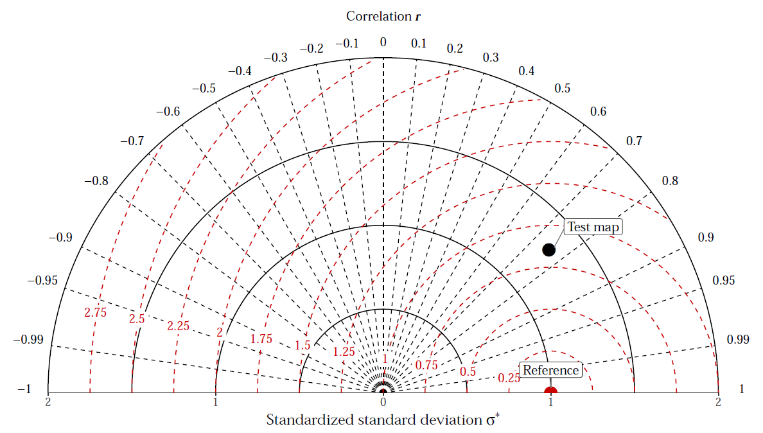
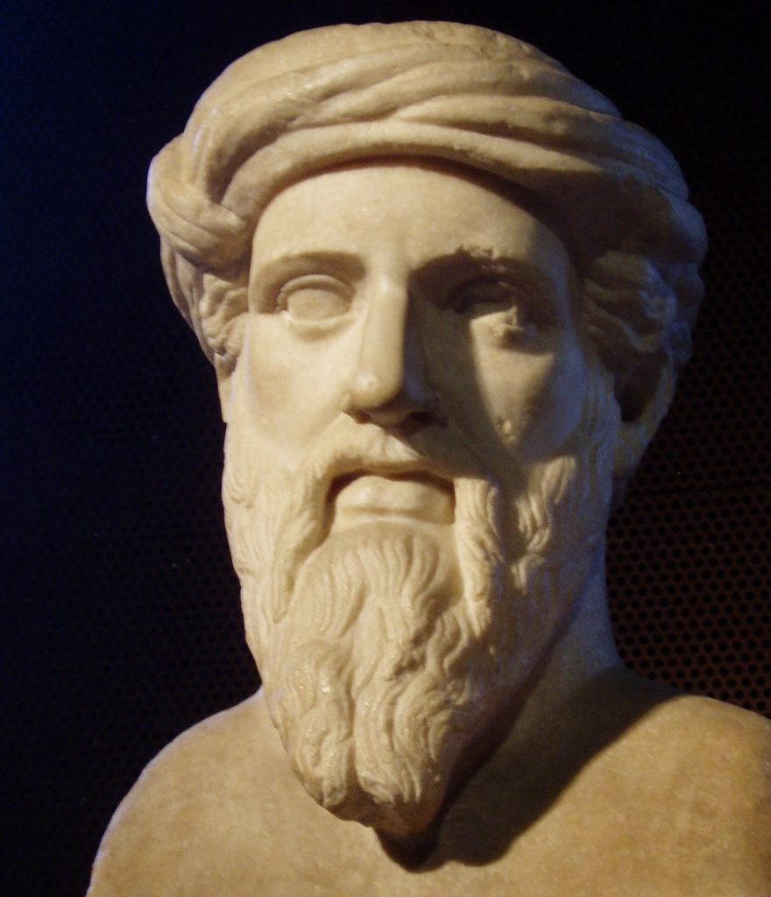
Taylor diagram
Standard deviation of the error (SDE)
Correlation $r$
Standard deviation of observed $σ_{z}$ and predicted $σ_{\hat{z}}$ values
$${SDE}^{2}={ σ}_{z}^{2}+{ σ}_{\hat{z}}^{2}+2σ_{z}σ_{\hat{z}}r$$
$$a^{2}=b^{2}+c^{2}+2bc\cos{α}$$
Notes:
Geometrical relationship in the triangle through the law of cosines and the Pythagorean theorem.

Slide 6
Taylor diagram
$${SDE}^{2}={ σ}_{z}^{2}+{ σ}_{\hat{z}}^{2}+2σ_{z}σ_{\hat{z}}r$$
$$SDE$$
No information on bias
Notes:
Polar coordinate system
Provides information about
Precision (semicircles around the reference point),
Spatial (or temporal) patterns (r)
The degree of smoothing (semicircles around the origin)

Slide 7
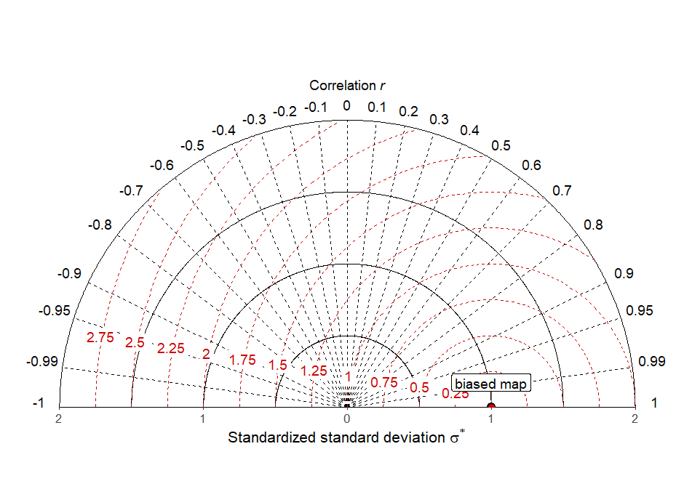
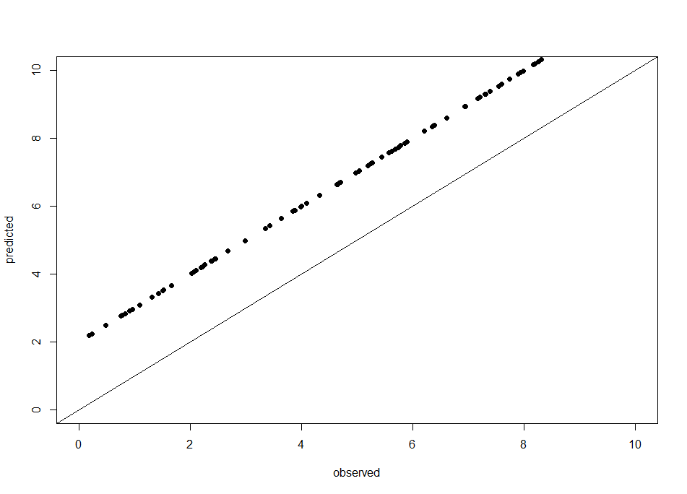
Taylor diagram
No information on bias

Slide 8
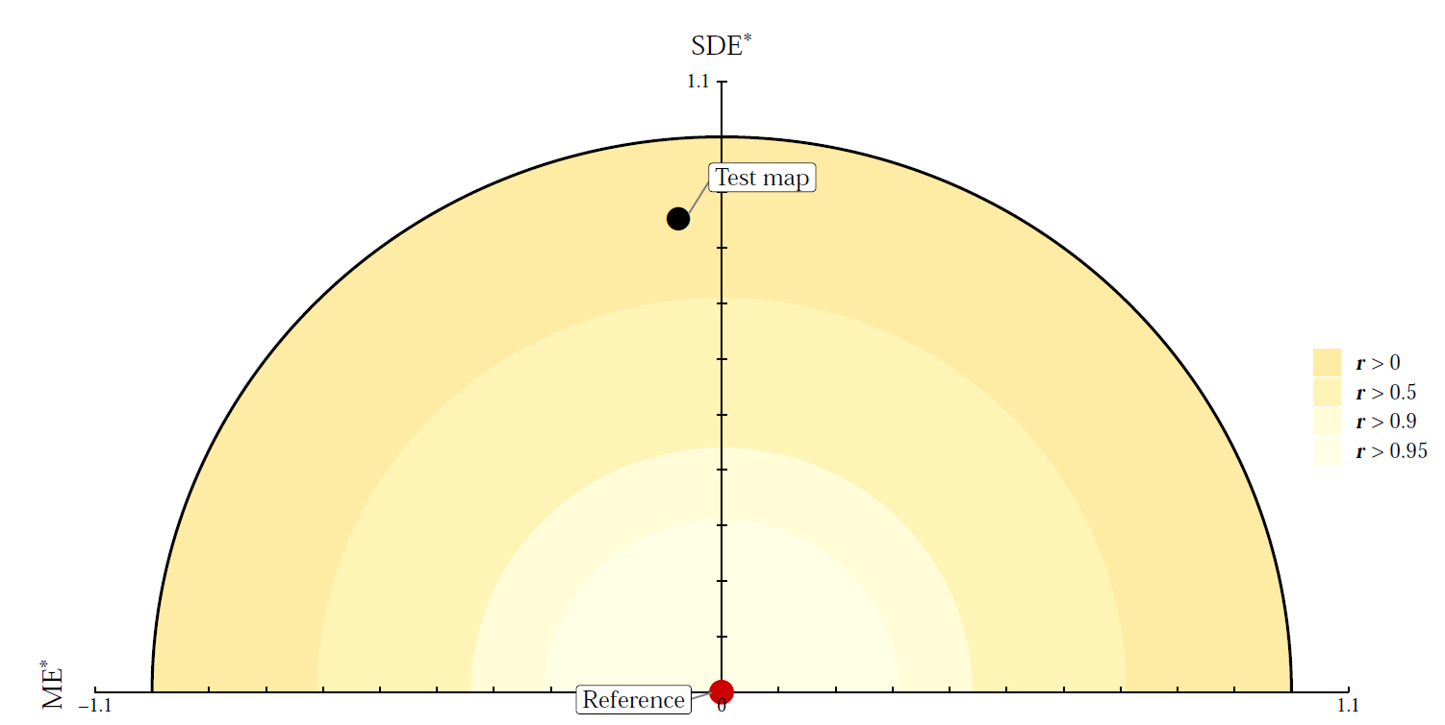
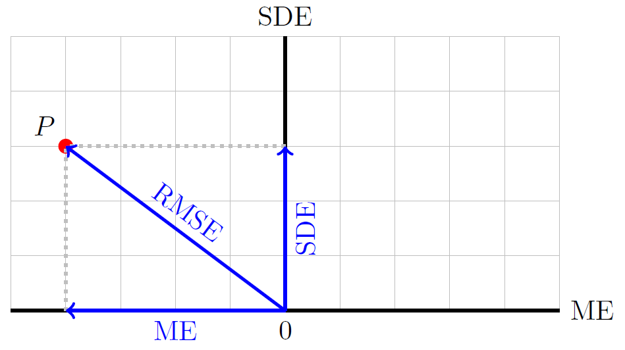
Solar diagram
Standard deviation of the error (SDE)
Mean error (ME)
$$RMSE^{2}=ME^{2}+SDE^{2}$$
Notes:
Cartesian coordinate system

Slide 9
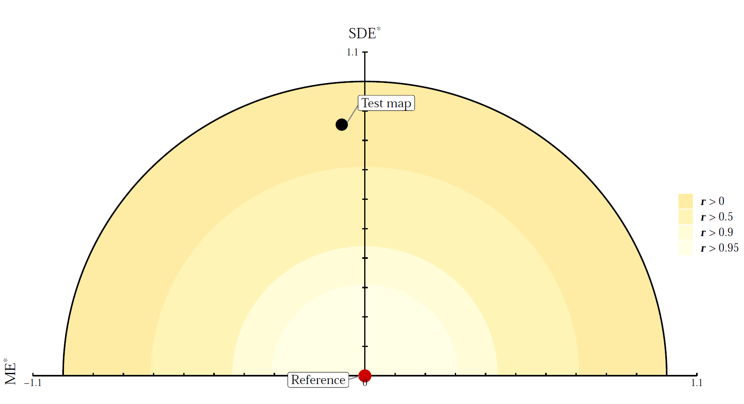
Solar diagram
Standard deviation of the error (SDE)
Mean error (ME)
RMSE
Pearson’s r correlation
Modelling efficiency (MEC)
Colour scale
MEC = 0
RMSE

Slide 10
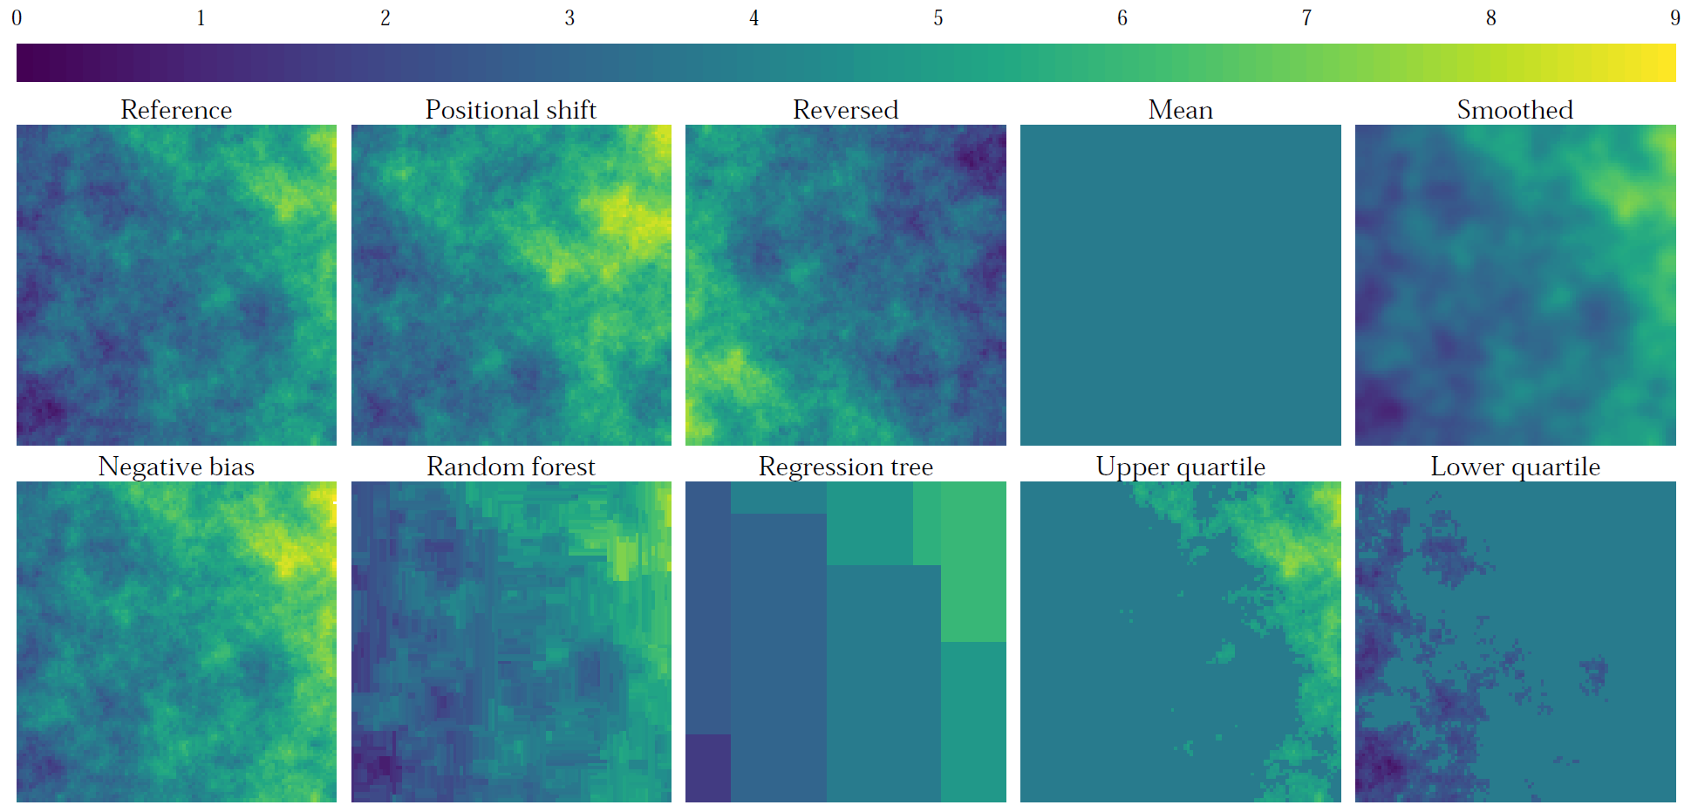
Example: simulation study
Simulated map:
gaussian field C(h) = 5 exp(-h/10) and linear trend

Slide 11
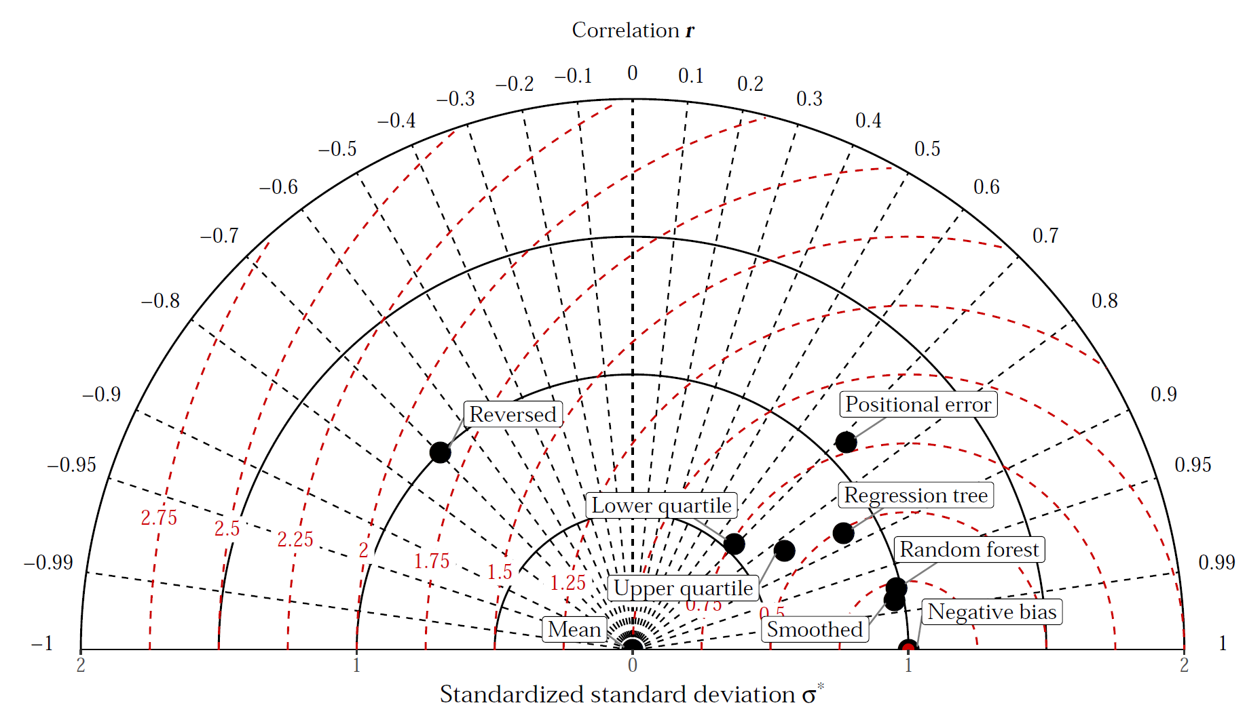
Example: simulation study
Notes:
The reversed map is the farthest from the reference.
The smoothed and random forest maps seem the closest, and indeed their pattern appear close to the reference map.
The problem here is that the negative bias map appears the closest to the reference point.

Slide 12
Example: simulation study

Slide 13
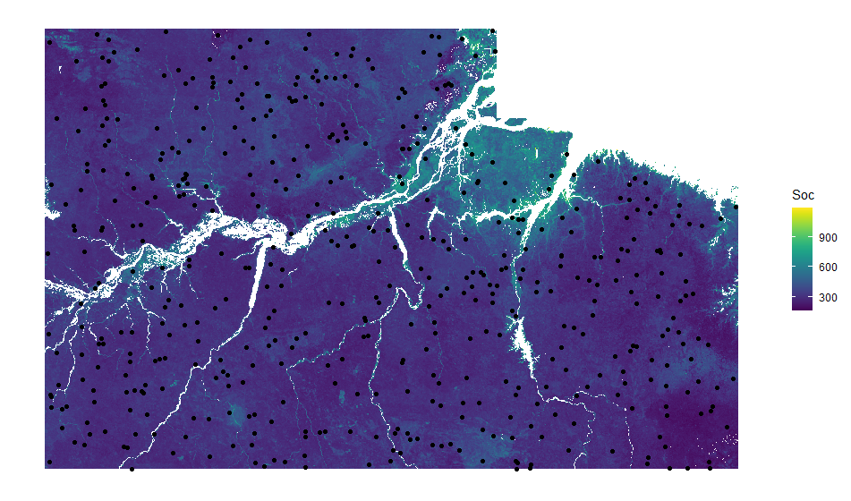
Example: tracking effect of model parameters
Mapping of topsoil organic carbon density in Eastern Amazonia
- 500 sampling locations
- 28 environmental predictors
Generalized boosted regression tree:
Learning rate (small values = many trees)
Depth - maximum depth of each tree
We test 10 combinations of parameters values selected with Latin hypercube sampling.
Learning rate between 1×10⁻⁵ and 1
Depth between 1 and 10
Notes:
1 times 10 to the negative 5

Slide 14
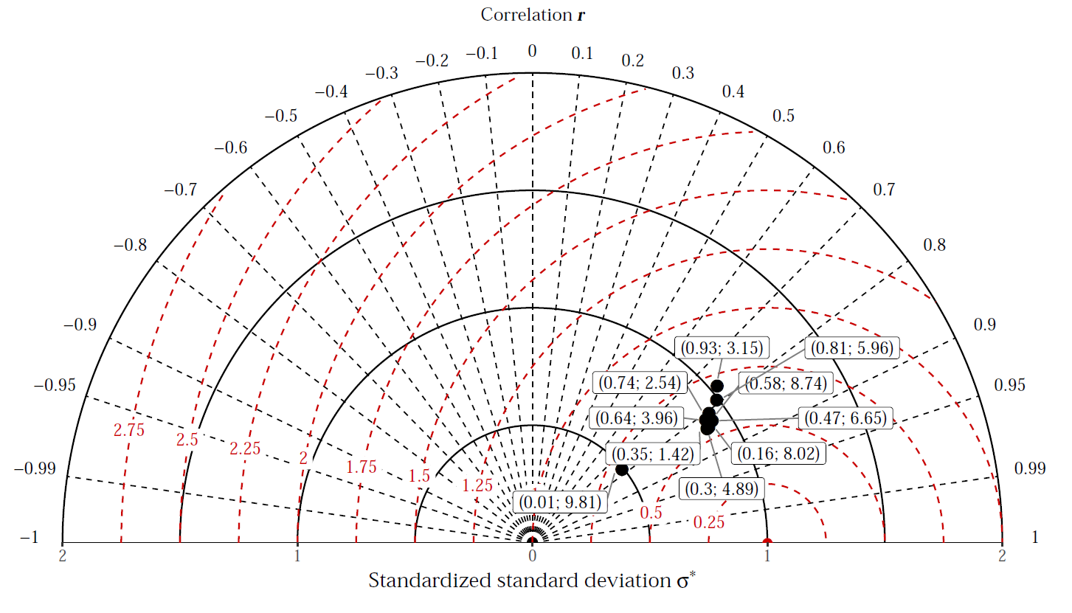
Example: tracking effect of model parameters
Notes:
Values clustered between r values 0.7 and 0.9 and SDE value between 0.5 and 0.75.
Preferable small value of the learning rate and a rather large value of the depth.
Worse results found for small value of the learning rate and large depth parameter.

Slide 15
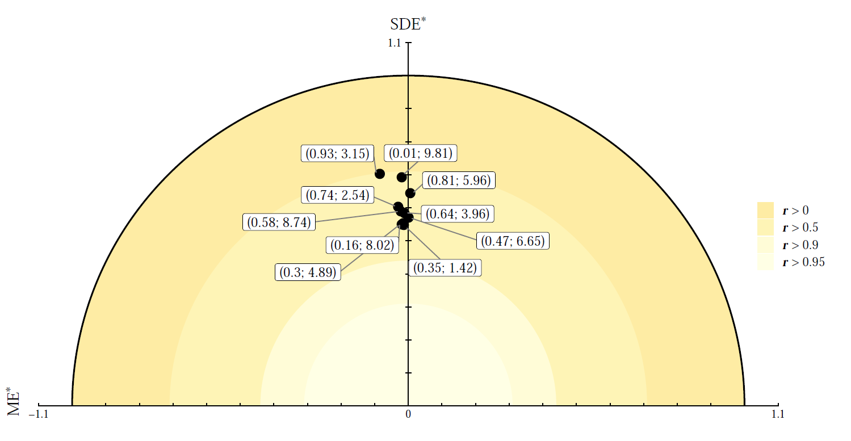
Example: tracking effect of model parameters
Notes:
Values clustered with r values larger than 0.5
Little bias.
Preferable small value of the learning rate and a rather large value of the depth.
Worse results found for high value of the learning rate and large depth parameter.
Point at 0.01 and 9.81 appeared the worse before, but with the bias included it is not the worse anymore

Slide 16
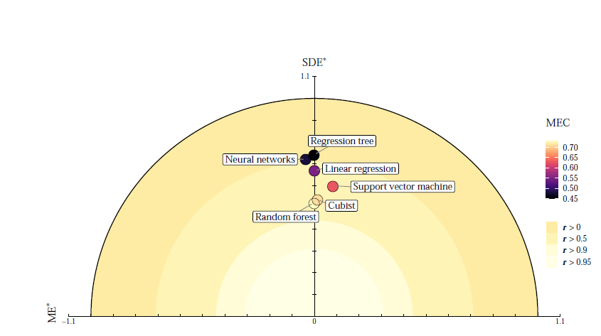
Summary
No single statistical index represents all aspects of the map quality.
It is sensible to use the statistical relationship between indices.
Taylor diagram represents correlation, standard deviation of the predicted and observed values and standard deviation of the error.
Taylor diagram has no information on bias.
Solar diagram represents bias, RMSE, correlation and MEC.
Map quality should be interpreted with respect to the objective!
Notes:
Linear regression and SVM differ in RMSE, SDE and r values, but mostly in terms of bias. If the aim is to use the map as input to a process model, then one probably would prefer the SVM model because the additional bias is judged to be less of a problem than underestimating spatial variation.
To obtain easily interpretable models, one may focus on either a linear regression or a regression tree without important decrease in SDE and RMSE.
Smoothing = SDE
Pattern = r

Slide 17
An integrated approach for the evaluation of quantitative soil maps through Taylor and solar diagrams
Wadoux A.M.J-C., Walvoort D.J.J and Brus D.J. (2021) An integrated approach for the evaluation of quantitative soil maps through Taylor and solar diagrams. Under review
Code and reproducible example: https://github.com/AlexandreWadoux/MapQualityEvaluation
Alexandre Wadoux
alexandre.wadoux@sydney.edu.au
Questions?

